Slide 1

Starbucks Data Analysis
The
Store Distribution Analysis

Slide 2

How the Starbucks stores distributed globally?
Does store ownership
have any demographic relationship?
Does climate have any impact on store distribution?

Slide 3
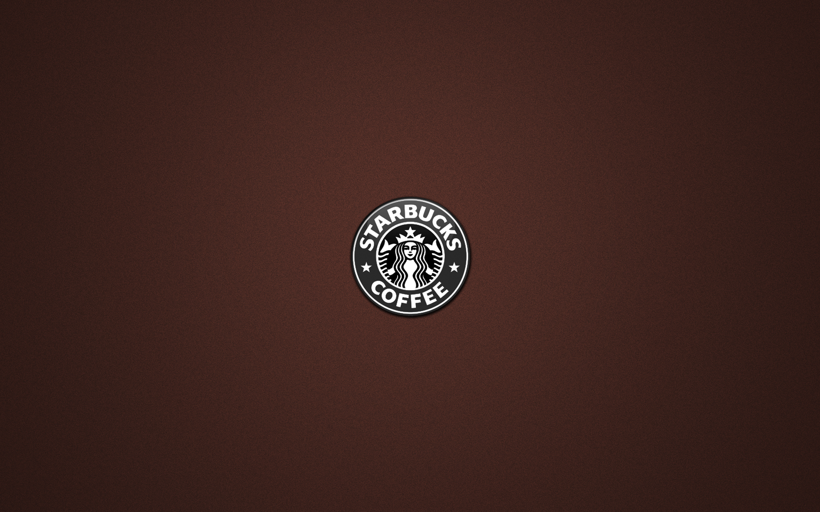
STARBUCKS LOCATION BASED ON INCOME
Starbucks Distribution Across USA
What is the store distribution?
How competitive is the coffee business

Slide 4

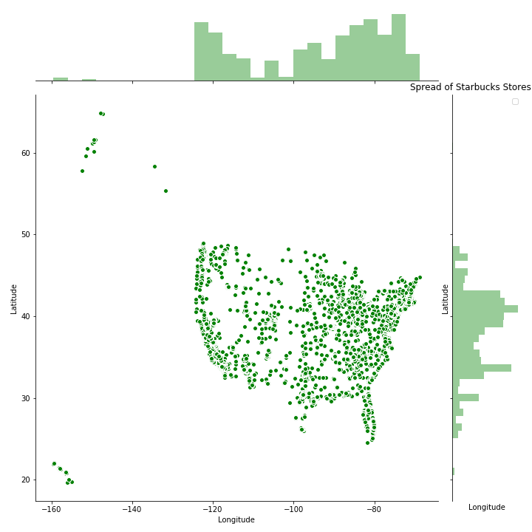
Starbucks Stores across United States:
There are 13,930 Starbucks Stores Across the US as at 2017 till Date.
8,222 Stores are Company Operated while 5708 are Licensed Stores

Slide 5
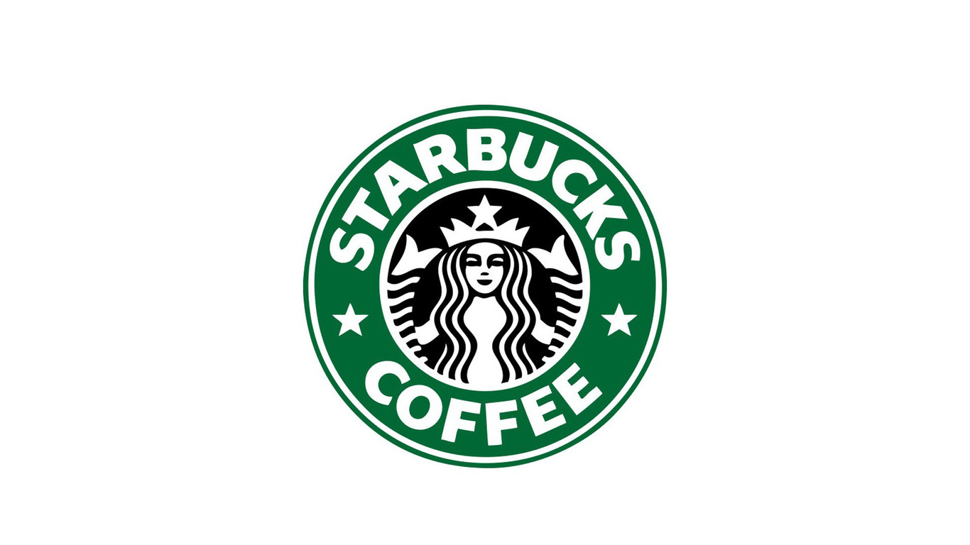
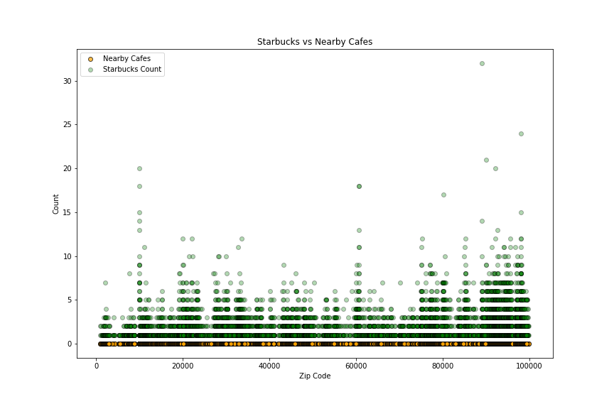
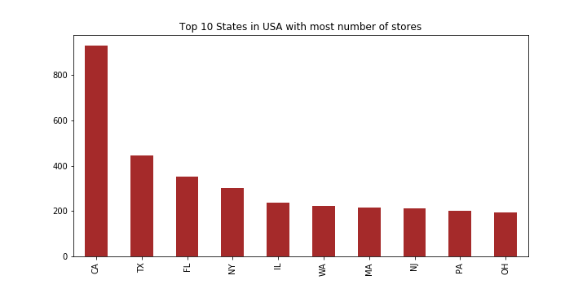
Starbucks Shops Vs Nearby Coffee Shops by Zipcodes

Slide 6
Starbucks Demographics Distribution Facts Across the USA
Does population per state or race have any relationship with store count ?
Does Starbucks target a specific age group?
Does income have any relationship with store distributions?

Slide 7
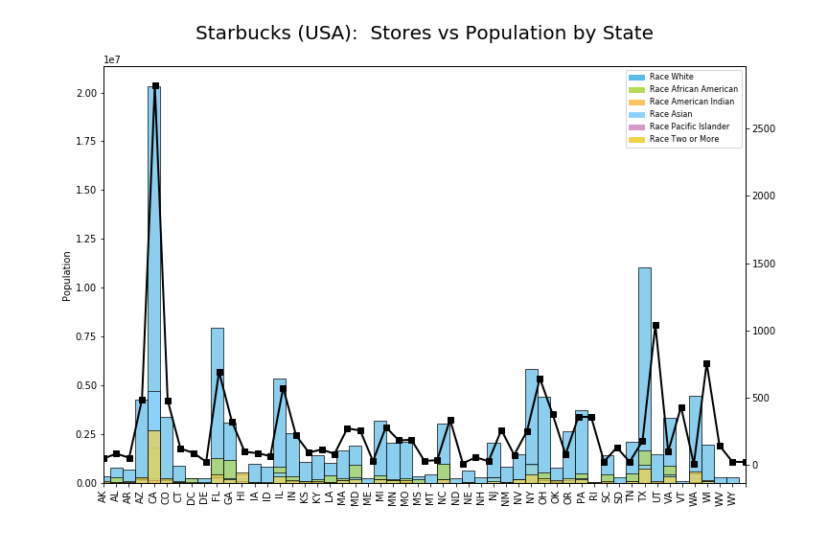
Starbucks Stores Count based on Race in the US by their Zipcodes
Observation:
As we can see from the Bar Chart that California, Texas, Florida, New York and Illinois
[2821, 1,042, 694, 645, 575] pretty has a the highest number of Store across the US, Which obviously indicates that there a relationship of Starbucks Stores and Population.
Also Washington DC, Detroit, Arkansas, North Dakota, Vermont , Rhode Island and Wyoming has few Stores which could depend on Population around these states.

Slide 8
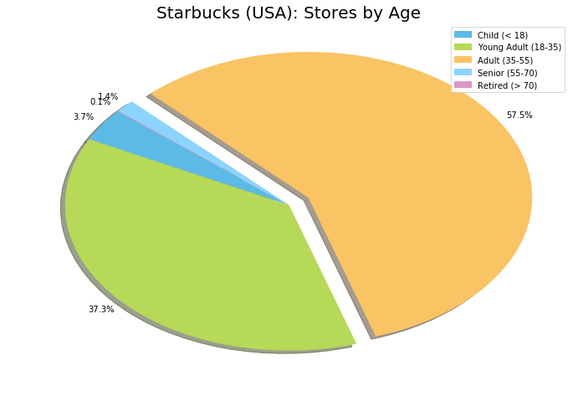
STARBUCKS TARGET BY AGE GROUP
Based on the Pie Chart Analysis, Starbucks stores target the Age group individuals 35-55 (57.5%)
Young Adult Individual 18-35 (37.3%)
And Few number of Store are found amongst individual 55-70 (3.7%)

Slide 9
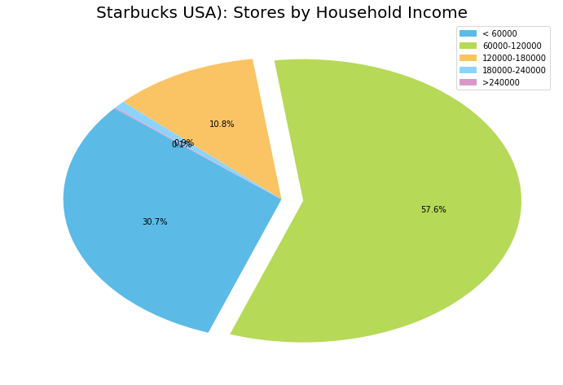
STARBUCKS TARGET BY HOUSEHOLD INCOME
Based on the Pie Chart Analysis, Starbucks stores target the individuals that earns 60,000 – 120,000 (57.6%)
Young Adult Individual that earns less than 60,000 (30.7%)
And Few number of Store are found amongst individual that earns 180,000 – 240,000 (10.8%)

Slide 10

STARBUCKS GLOBAL
DIDTRIBUTION ANALYSIS
Also,
There are Only three(3) countries in Africa that has Starbucks Stores, Which are Morrocco, Egypt and South Africa
And Few of the Stores are scattered in the Middle East
As Observed from the link below,
There are a lot of Starbucks Store Distribution
In the Continent of North America, Europe and Also Asia.
https://sunkanmi.carto.com/builder/c091e279-b1df-4540-b5b8-15da62e445c3/layers

Slide 11
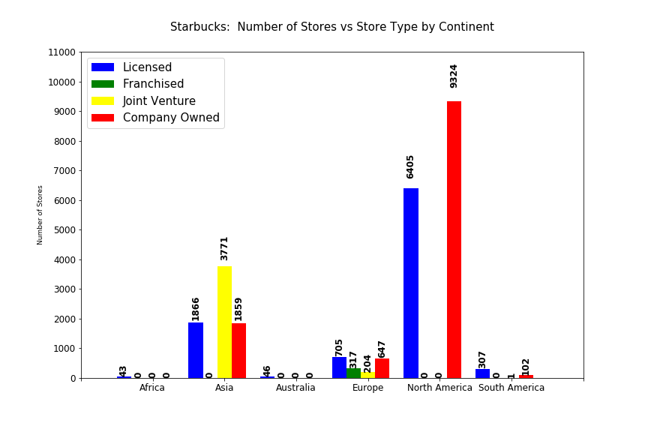
STORE OWNERSHIP VS DEMOGRAPHIC RELATIONSHIP
From the Bar Chart
It Shows that Most Starbucks Stores in North America are Company Owned and a lot of them are Licensed Owned as well
Asia Stores are Mostly Joint Ventures and Few Company and Licensed Owned
Europe has almost Equal Licensed and Company owned Stores
Zero Stores in Australia
And Few Stores are Licensed owned on South Africa

Slide 12
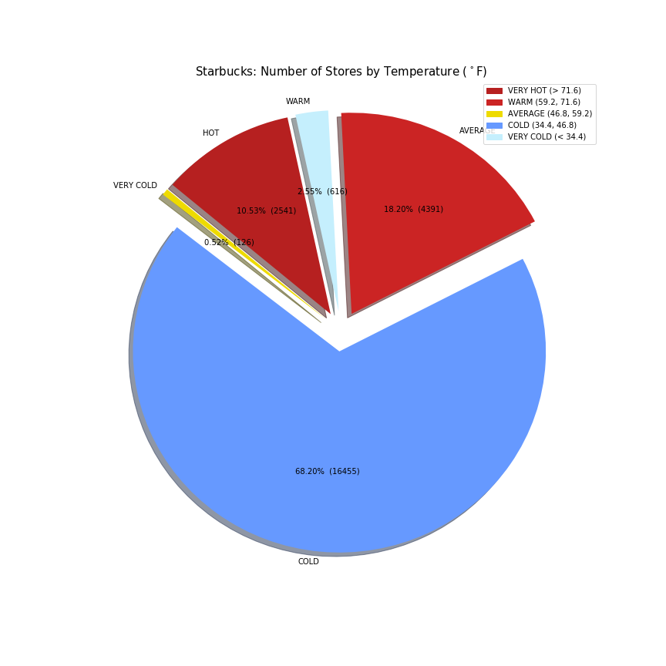
Climate impact on Starbucks stores globally
From the Pie Chart
It Shows that Most Starbucks Stores are Situated in Cold Region about 68.20% of the Stores are based in Cold Countries globally.
18.20% of the Stores are in Warm Countries.
10% of the Stores are in Hot Region

